Slide 1
Floriculture CDE
Plant Identification

Slide 2
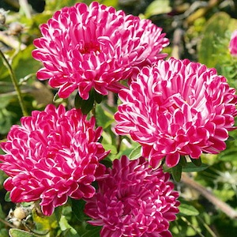
Callistephus chinensis Aster

Slide 3
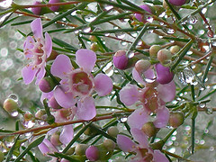
Chamelaucium uncinatum Waxflower

Slide 4
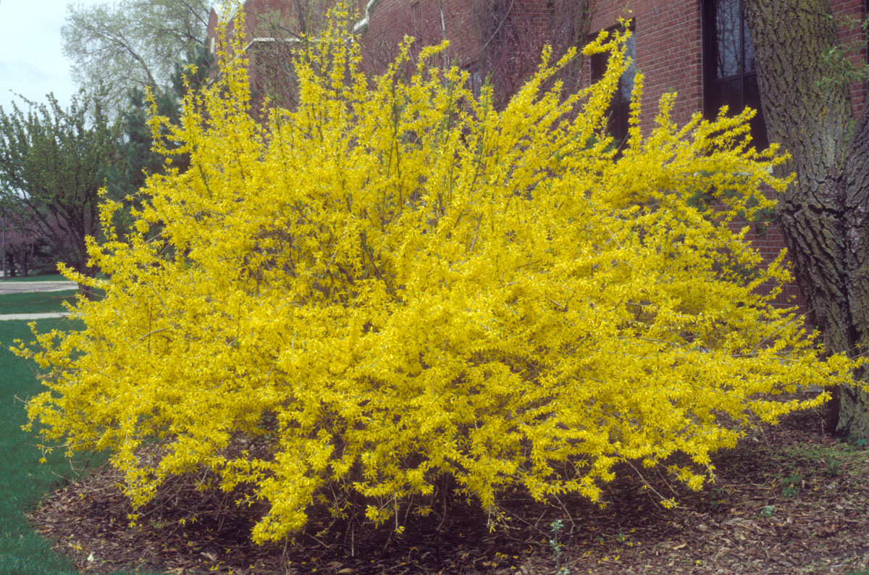
Forsythia x intermedia Forsythia

Slide 5
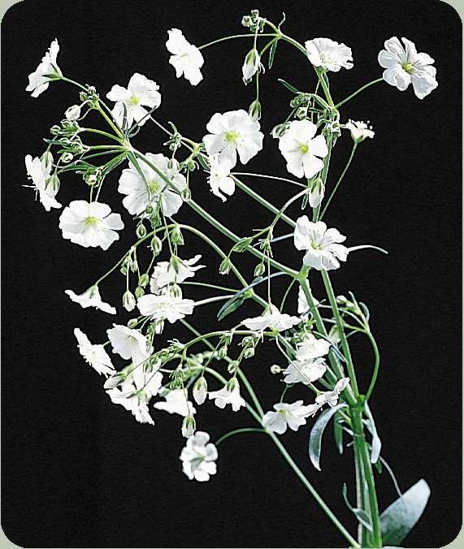
Gypsophila elegans cv. Baby’s breath

Slide 6
Limonium ferulaceum Caspis, Misty Blue

Slide 7
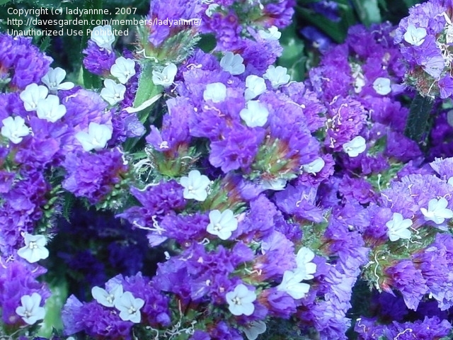
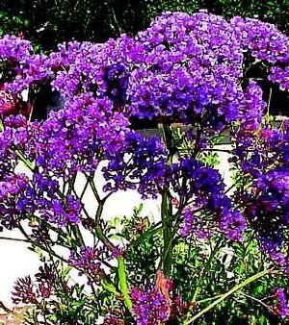

Slide 8
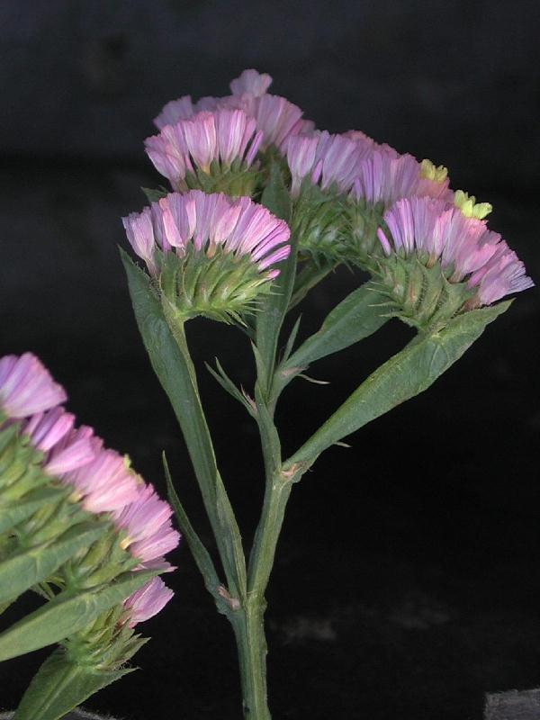
Limonium sinuatum cv. Statice

Slide 9
Erica carnea Spring Heather

Slide 10
Stephanotis floribunda Stephanotis, Bridal Wreath

Slide 11
Antirrhinum majus cv. Snapdragon

Slide 12
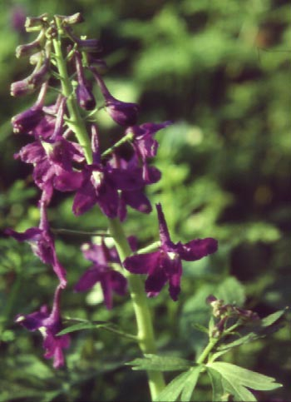
Consolida ambigua cv. Larkspur

Slide 13
Delphinium elatum Delphinium

Slide 14
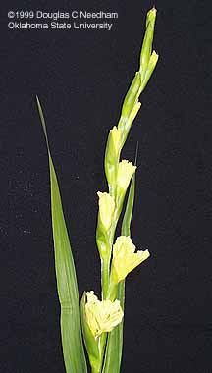
Gladiolus x hortulanus cv. Gladiolus

Slide 15
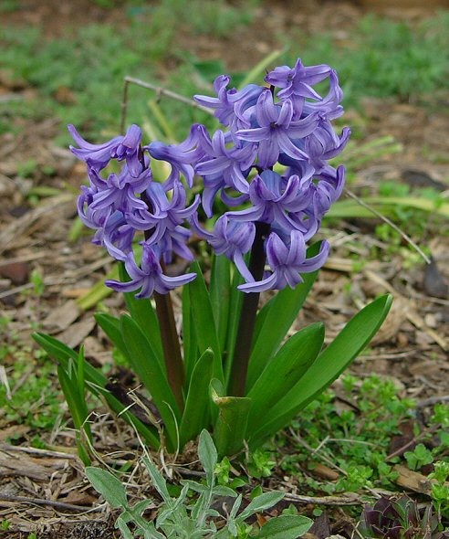
Hyacinthus orientalis cv. Hyacinth

Slide 16
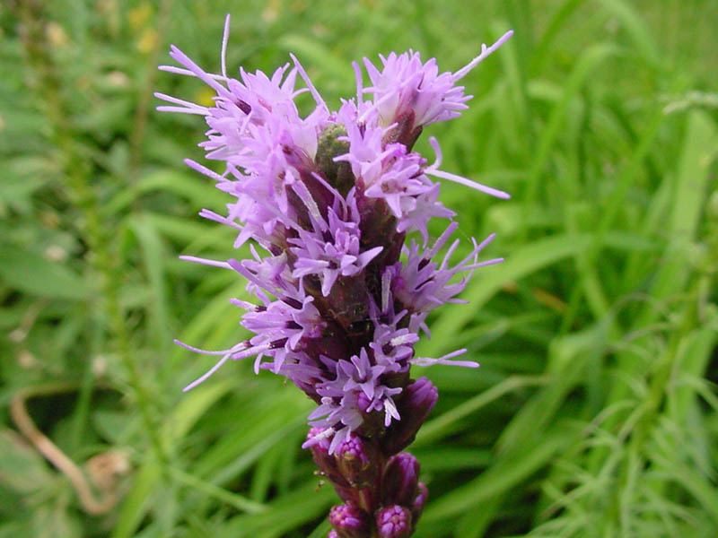
Liatris spicata Liatris

Slide 17
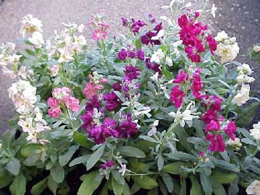
Matthiola incana Stock

Slide 18
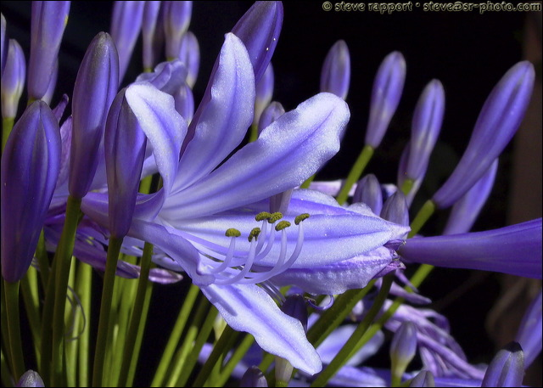
Agapanthus africanus African Lily, Lily of the Nile

Slide 19
Alstroemeria aurantiaca Alstroemeria, Peruvian Lily

Slide 20
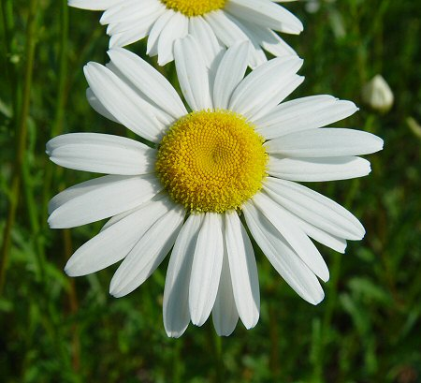
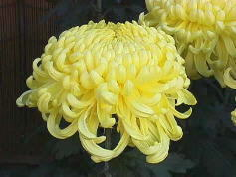
Chrysanthemum X morifolium cv Florist’s Chrysanthemum

Slide 21
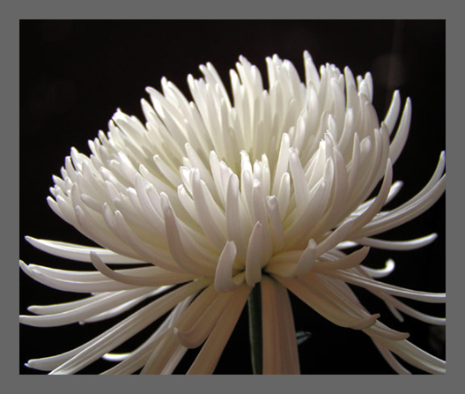
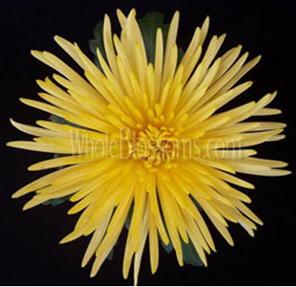

Slide 22
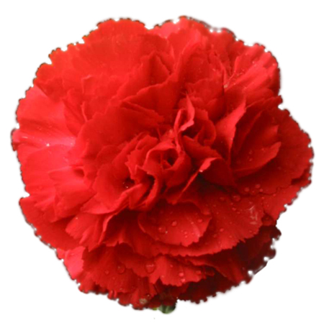
Dianthus cv. Carnation

Slide 23
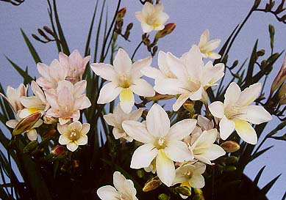
Freesia x hybrida Freesia

Slide 24
Helianthus annuus cv. Sunflower

Slide 25
Gerbera jamesonii cv. Gerbera, Transvaal Daisy

Slide 26
Hydrangea marcrophylla Hydrangea

Slide 27
Paeonia lactiflora cv. Peony

Slide 28
Rosa cv. Hybrid Tea Rose

Slide 29
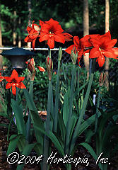
Hippeastrum x hybridum cv. Amaryllis

Slide 30
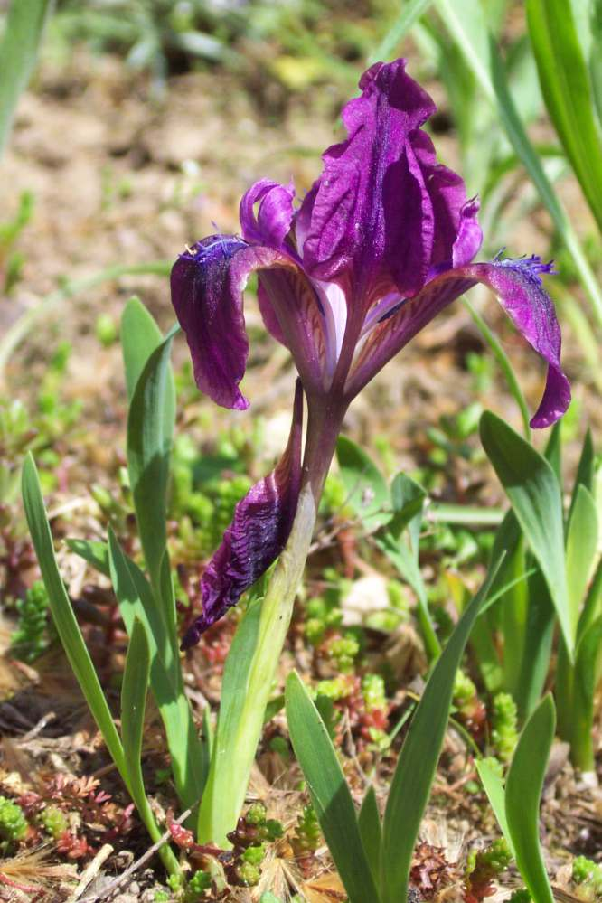
Iris spp. Iris

Slide 31
Lilium cv. ‘Stargazer’ Stargazer Lily

Slide 32
Lilium longiflorum cv. Trumpet Easter Lily

Slide 33
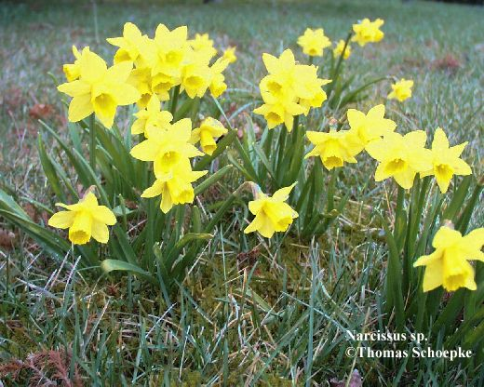
Narcissus hybrid Daffodil

Slide 34
Phalaenopsis cv. Phalaenopsis, Butterfly Orchid

Slide 35
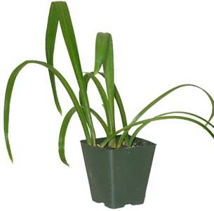
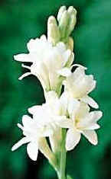
Polianthes tuberosa Tuberose

Slide 36
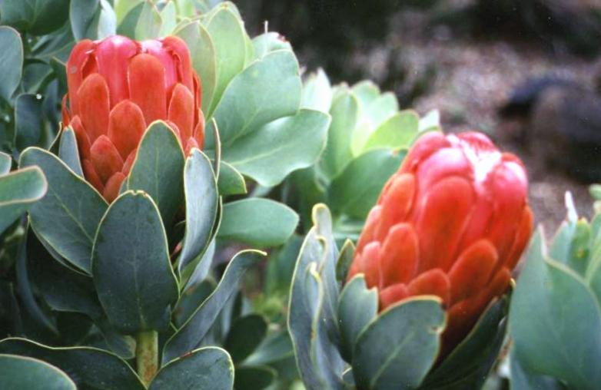
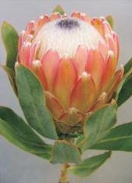
Protea cv. Protea

Slide 37
Strelitzia reginae Bird of Paradise

Slide 38
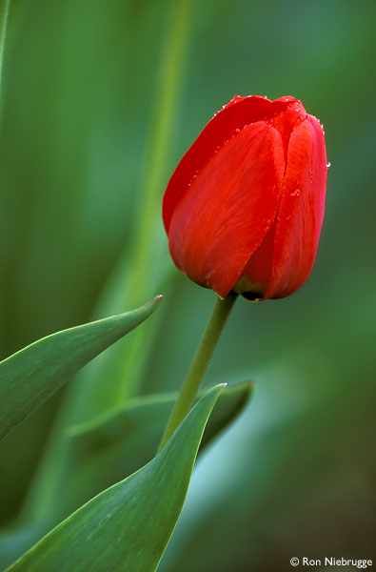
Tulipa cv. Tulip

Slide 39
Zantedeschia aethiopica Calla

Slide 40
Schlumbergera truncata cv. Thanksgiving Cactus

Slide 41
Begonia X tuberhybrida cv. Tuberous Begonia

Slide 42
Kalanchoe blossfeldiana cv. Kalanchoe

Slide 43
Rhododendron cv. Azalea

Slide 44
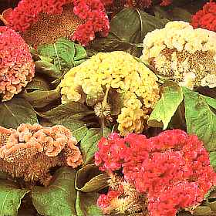
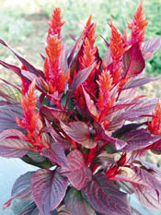
Celosia argentea cv. Celosia, Cockscomb

Slide 45
Spathiphyllum spp. Spathiphyllum, Peace lily

Slide 46
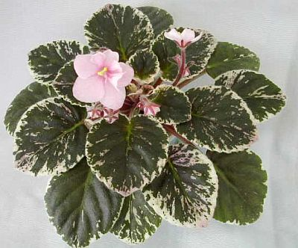
Saintpaulia ionantha cv. African Violet

Slide 47
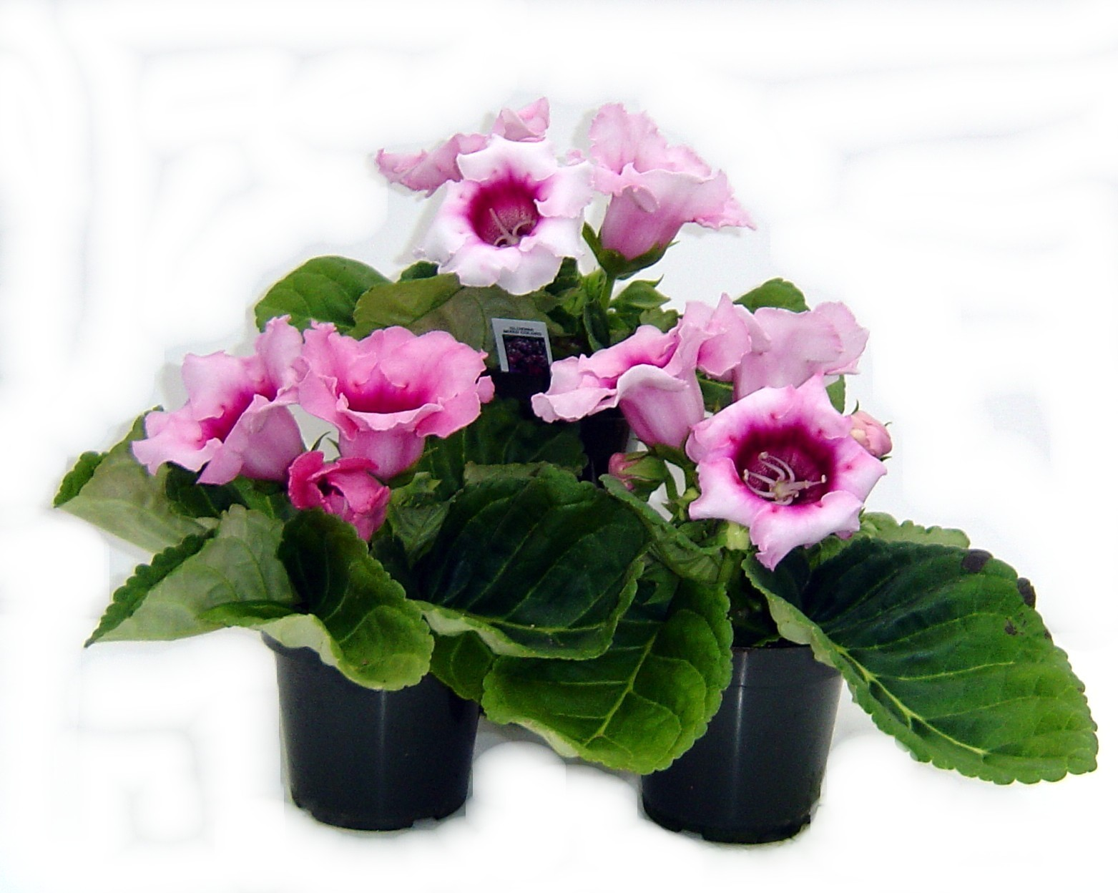
Sinningia speciosa cv. Gloxinia

Slide 48
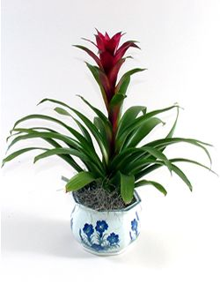
Aechmea cv. Bromeliad

Slide 49
Alpinia purpurata Ginger

Slide 50
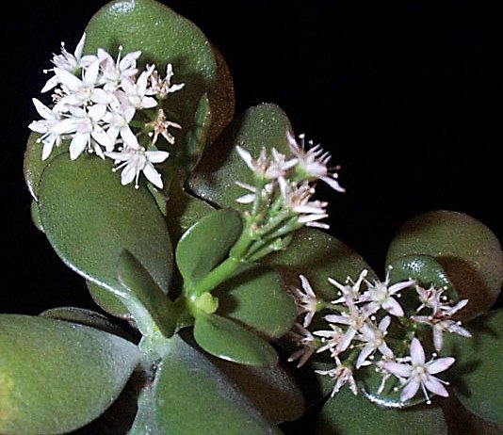
Crassula argentea Jade Plant

Slide 51
Cyclamen persicum cv. Florist’s Cyclamen

Slide 52
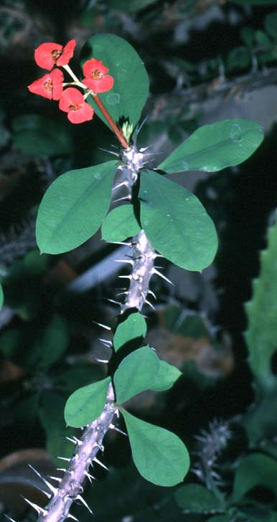
Euphorbia milii var. Crown of Thorns

Slide 53
Euphorbia pulcherrima cv. Poinsettia

Slide 54
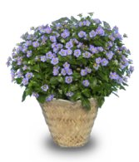
Exacum affine German Persian Violet

Slide 55
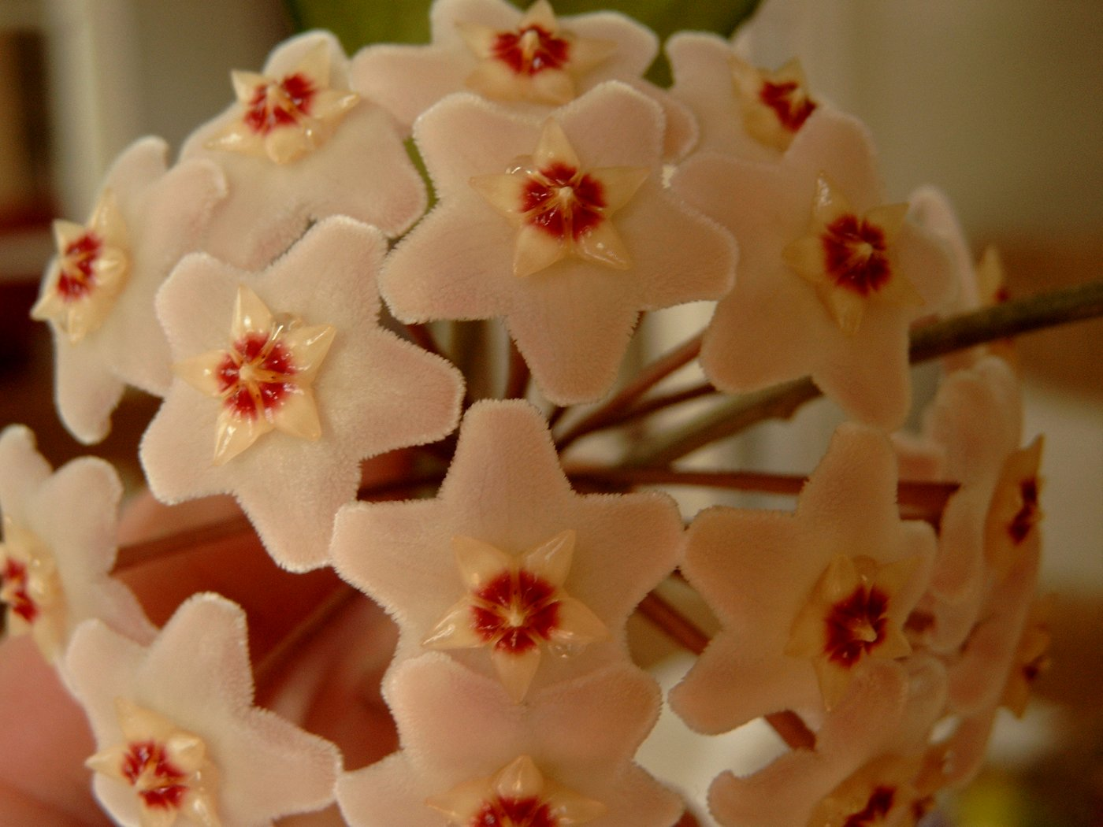
Hoya carnosa var. Wax Plant

Slide 56
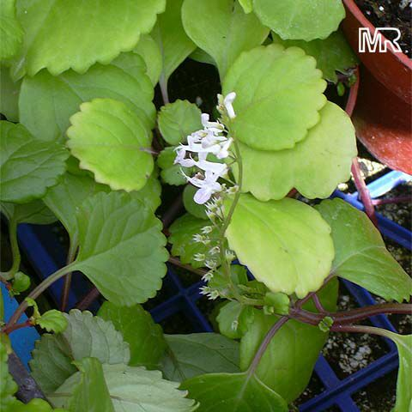
Plectranthus australis Swedish Ivy

Slide 57
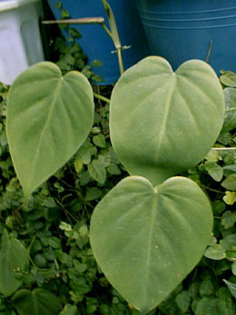
Philodendron scandens oxycardium Heartleaf Philodendron

Slide 58
Nephrolepis exaltata cv. Boston Fern

Slide 59
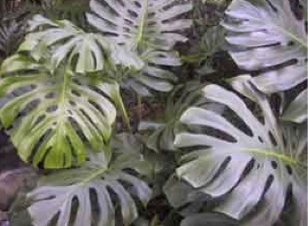
Monstera deliciosa Split-leaf Philodendron

Slide 60
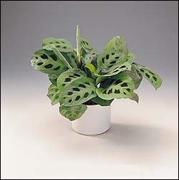
Maranta leuconeura cv. Prayer Plant

Slide 61
Peperomia Watermelon Peperomia

Slide 62
Syngonium podophyllum Nepthytis

Slide 63
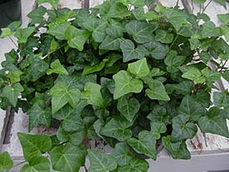
Hedera helix cv. English Ivy

Slide 64
Zebrina pendula cv. Wandering Jew

Slide 65
Sansevieria trifasciata cv. Snake Plant, Sansevieria

Slide 66
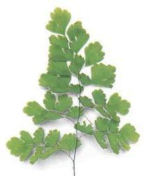
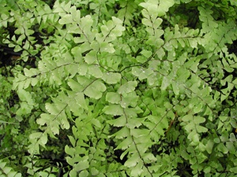
Adiantum spp. Maidenhair Fern

Slide 67
Aglaonema commutatum cv. Aglaonema, Chinese Evergreen

Slide 68
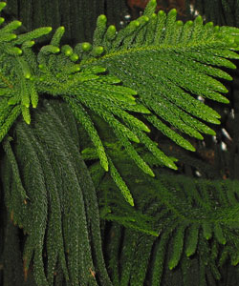
Araucaria heterophylla Norfolk Pine

Slide 69
Asparagus densiflorus ‘Myriocladus’ Ming Fern

Slide 70
Asparagus densiflorus ‘Sprengeri’ Sprengeri

Slide 71
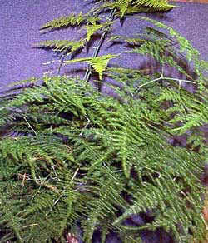
Asparagus setaceus Plumosa Fern

Slide 72
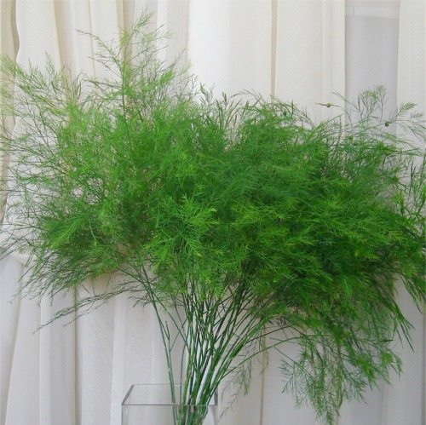
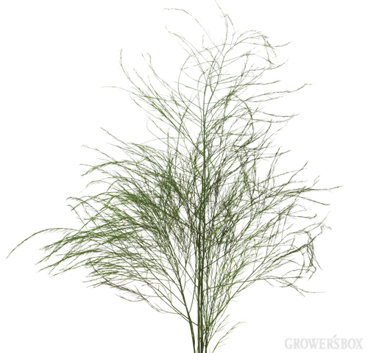
12. Asparagus setaceus ‘Pyramidalis’- Tree Fern

Slide 73
Beaucarnea recurvata Ponytail Palm

Slide 74
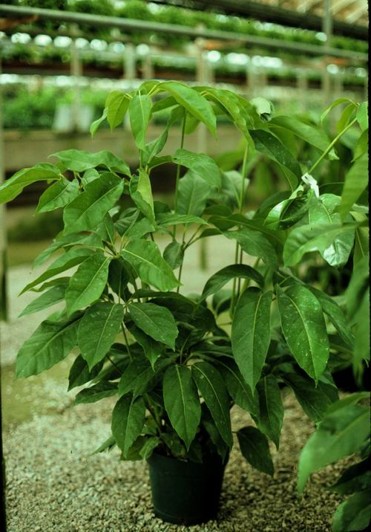
Brassaia actinophylla Schefflera, Octopus tree

Slide 75
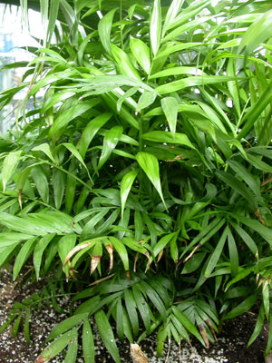
Chamaedorea elegans Parlor Palm, Chamaedor Palm

Slide 76
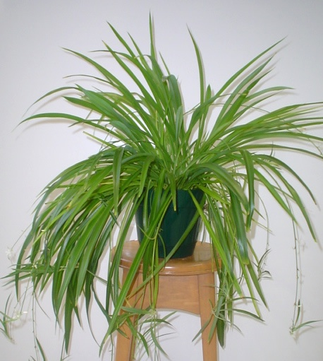
Chlorophytum comosum var. Spider Plant

Slide 77
Codiaeum variegatum cv. Croton

Slide 78
Cordyline terminalis Ti Plant

Slide 79
Dieffenbachia spp. Dieffenbachia, Dumb Cane

Slide 80
Asplenium nidus Bird’s Nest Fern

Slide 81
Dizygotheca elegantissima False Aralia

Slide 82
Dracaena fragrans ‘Massangeana’ Corn Plant Dracaena

Slide 83
Dracaena marginata var. Red-margined dracaena

Slide 84
Epipremnum aureum cv. Golden Pothos, Devil’s Ivy

Slide 85
Ficus benjamina ‘Exotica’ Benjamin Fig, Weeping Fig

Slide 86
Ficus elastica ‘Decora’ Rubber Tree

Slide 87
Ficus lyrata Fiddle leaf Fig

Slide 88
Pittosporum tobira cv. Pittosporum, Mock Orange

Slide 89
Vaccinium ovatum Huckleberry

Slide 90
Gaultheria shallon Lemonleaf, Salal

Slide 91
Eucalyptus

Slide 92
Galax urceolata Galax

Slide 93
Rumorha adiantiformis Leatherleaf Fern

Slide 94
Moluccella laevis Bells of Ireland

Slide 95
Xerophyllum tenax Bear Grass

Slide 96
Salix matsudana cv. Curly Willow

Slide 97
Salix discolor cv. Pussy Willow

